Slide 1

Release 2.0 – The NBility model
Netbeheer Business Capability Model
April 2022

Slide 2
Content presentation: the NBility model
Description parts of the NBility model
This presentation contains the NBility model with the Business capabilities, the Value streams and the Business objects of a Grid operator.
This presentation contains animations.
The English descriptions of the business capabilities are in column F of excel file ‘NBility 2.0’
2

Slide 3
Business capabilities
Level 1
Guide the company
Serve
customers
Transport energy
Manage development and maintenance of energy grids
Measure energy flows and grids
Perform work on
energy grids
Facilitate the energy market
Support the company

Slide 4
Business capabilities
Level 2
7. Guide the company
1. Serve
customers
2 Transport energy
3. Manage development and maintenance of energy grids
4. Measure energy flows and energy grids
5. Perform work on
energy grids
6. Facilitate the energy market
.1. Serve customers and maintain relations
.1. Control energy transport
.1. Extend, replace and renew energy grids
.1. Obtain measurements
.1. Create and maintain work portfolio
.1. Serve market parties and maintain relations
.2. Acquire and manage contracts
.2. Restore energy transport
.2. Maintain energy grids
.2. Direct work execution
.2. Manage market data
.3. Invoice and collect
.3. Create transport and switching plans
.3. Establish energy grid guidelines and patterns
.2. Distribute measurements
.3. Execute work
.3. Perform/facilitate market processes
.4. Limit loss of income
.4. Support work
.4. Enable market data distribution
8. Support the company

Slide 5
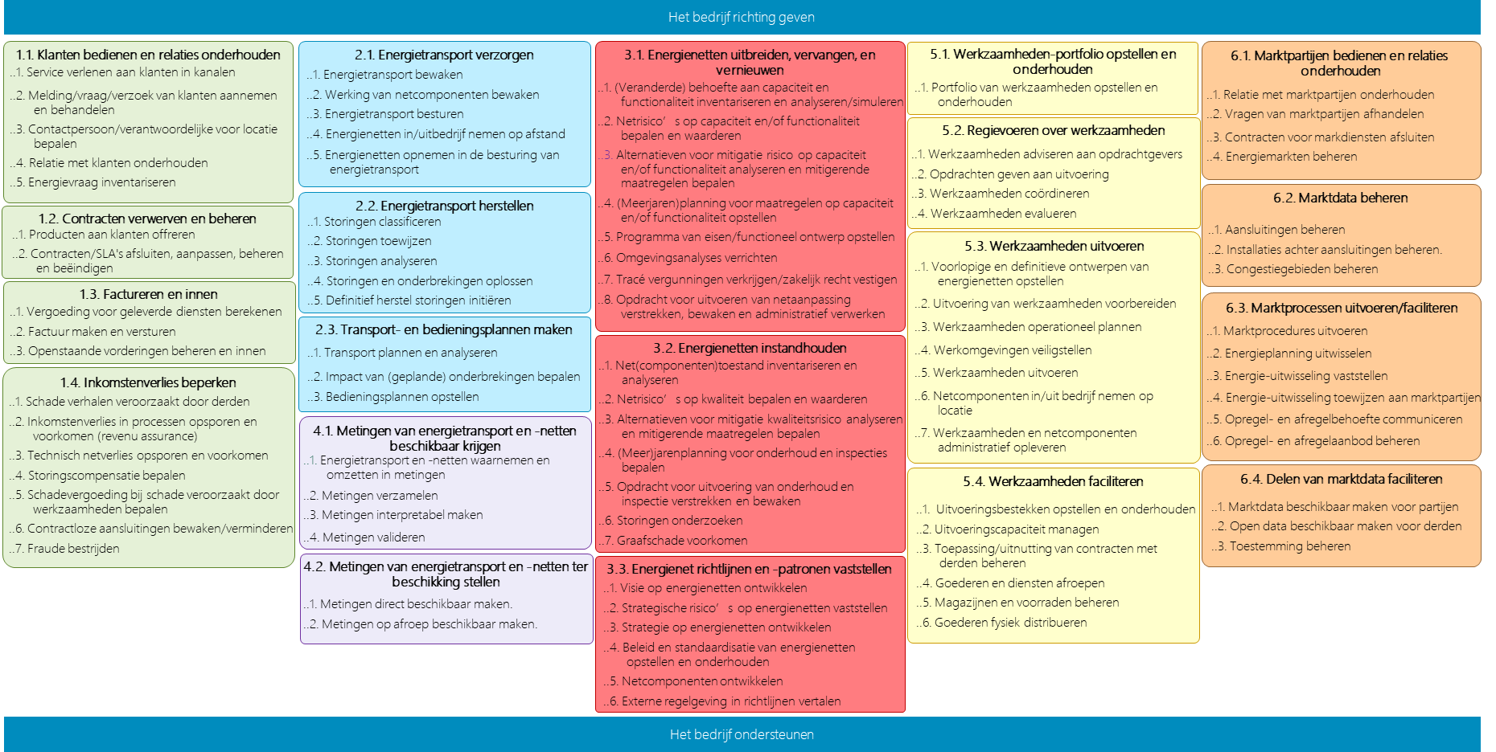
Business capabilities
Guide the company
Niveau 3
1.1. Serve customers and maintain relations
2.1. Realise energy transport
3.1. Manage the development and maintenance of energy grids
5.1. Create and maintain work portfolio
6.1. Serve market parties and maintain relations
..1. Provide service to customers
..2. Handle customer report/question/request
..3. Determine contact person/responsible person for location
..4. Maintain relationship with customers
..5. Collect energy demand
..1. Monitor energy transport
..2. Monitor the operation of grid components
..3. Control energy transport
..4. Commission/decommission energy grids on distance
..5. Include energy grids in the control of energy transport
..1. Prepare and maintain work portfolio
..1. Collect and analyse/simulate (changed) needs for capacity and functionality
..2. Determine and value grid risks on capacity and/or functionality
..3. Analyse alternatives for mitigation risk on capacity and/or functionality and determine mitigation measures
..4. (Long-term) plan measures on capacity and/or functionality
..5. Create Functional requirements/design
..6. Perform environmental analysis
..7. Obtain permits / lay down right in rem
..8. Issue, monitor and record grid adjustments
..1. Maintain relations with market parties
..2. Handle questions of market parties
..3. Close contracts for market services
..4. Manage energy markets
5.2. Direct work execution
..1. Advise clients on work
..2. Issue work to execution
..3. Coordinate work execution
..4. Evaluate work execution
2.2. Restore energy transport
6.2. Manage market data
1.2. Acquire and manage contracts
..1. Classify disturbances
..2. Assign disturbances
..3. Analyse disturbances
..4. Recover from disturbances and outages
..5. Initiate permanent disturbance recovery
..1. Quote products to customers
..2. Close, adjust, manage and terminate contracts/SLAs
5.3. Execute work
..1. Manage energy grid connections
..2. Manage installations behind connections
..3. Manage congestion areas
..1. Create preliminary and final design of energy grids
..2. Prepare execution of work
..3. Operationally plan work
..4. Secure the work environment
..5. Execute work
..6. Commission and decommision grid components on premises
..7. Complete work on energy grid components administratively
1.3. Invoice and collect
6.3. Perform/facilitate market processes
..1. Calculate compensation for services rendered
..2. Create and send invoice
..3. Manage and collect outstanding debts
2.3. Create transport and switching plans
..1. Execute energy market procedures
..2. Exchange energy predictions
..3. Determine energy exchange
..4. Allocate energy exchange to market parties
..5. Communicate upward or downward regulation need
..6. Manage upward or downward regulation bids
..1. Plan and analyse transport
..2. Determine impact of (planned) outages
..3. Create switching plans
3.2. Maintain energy grids
1.4. Limit revenue loss
..1. Inventorise and analyse grid and grid component status
..2. Determine and value grid risks on quality
..3. Analyse alternatives to mitigate quality risk and determine mitigating measures
..4. Determine (multi-)year planning for maintenance and inspections
..5. Provide and monitor maintenance and inspection orders
..6. Investigate malfunctions
..7. Prevent excavation damage
..1. Claim damage caused by third parties
..2. Detect and prevent revenue loss in processes (revenu assurance)
..3. Detect and prevent technical grid loss
..4. Determine disturbance compensation
..5. Determine compensation for damage caused by work activities
..6. Monitor and reduce connections without contract
..7. Fight fraud
4.1. Obtain measurements
..1. Perceive energy flows and energy grids and transform into measurements
..2. Collect measurements
..3. Make measurements interpretable
..4. Validate measurements
5.4. Support work
6.4. Enable market data distribution
..1. Create and manage execution specification
..2. Manage execution capacity
..3. Manage application and utilization of third party contracts
..4. Call off goods and services
..5. Manage warehouses and stock
..6. Distribute goods physically
..1. Make market data available to parties
..2. Make open data available for third parties
..3. Manage issued permissions
4.2. Distribute measurements
3.3. Establish energy grid guidelines and patterns
..1. Make measurements available immediately
..2. Make measurements available on demand
..1. Develop a vision on energy grids
..2. Identify strategic risks on energy grids
..3. Develop strategy on energy grids
..4. Develop and maintain policies and standards on energy grids
..5. Develop grid components
..6. Translate external regulations into guidelines
Support the company

Slide 6
Business capabilities per domain
Guide the company – Level 2
7. Guide the company
.1 Research and analyse the market
.2 Formulate vision, strategy and policies
.3 Monitor strategic and operational performance
.4 Define enterprise architecture
.5 Define and position brand
.6 Determe marketing and communication strategy
.7 Inform and manage stakeholders and other relations
.8 Monitor and adjust laws and regulations
.9 Develop and transform the organisation
.10 Manage research and innovation
.11 Develop industry collaboration
.12 Guarantee the financing of the company
6

Slide 7
Business capabilities per domein
Het bedrijf ondersteunen – Niveau 2
8. Support the company
.1 Manage knowledge, data and documents
.2 Guarantee information security and privacy
.3 Develop and maintain information provision
.4 Recruit, contract and manage suppliers
.5 Obtain and manage resources
.6 Manage office buildings and inventory
.7 Manage crisis's
.8 Develop and manage products and services
.9 Monitor and influence customer experience
.10 Conduct customer communication and campaigns
.11 Manage Projects, Programs and Portfolios
.12 Define, monitor, control and improve processes
.13 Provide external accountability
.14 Monitor and adjust quality
.15 Monitor and adjust safety, health and environment
.16 Monitor and adjust risks
.17 Monitor and manage finance
.18 Recruit, develop and manage staff
.19 Manage and monitor legal affairs
.20 Apply data science, engineering and analytics
7

Slide 8
Value streams
Value streams, Products and Markets
Value stream
Agree, connect and disconnect energy users
Reconstruct energy grids
Adjust energy grid plan driven
Maintain energy grids (maintenance + disturbance recovery)
Manage available energy grid capacity (near real time)
Transport energy (real time)
Allocate energy exchange to market parties
Distribute grid operator data
Product
Connection
Reconstructed energy grid
Future proof energy grid
Reliable energy grid
Transport capacity
Transported energy
Allocated energy exchange
Grid operator data
Market
Customer
Government, Customer
Society
Society, Customer
Society
Customer
Market party
Market party, Society
Notes:
Waardestromen

Slide 9
Business objects
Level 1
Customer
Energy market
demander in
realization of connection service offered on
realization of transport service offered on
Work
Energy grid
Energy transport
on
over
of
of
Measurement

Slide 10
Business objects
All levels
Customer
Energy transport
Energy grid
Measurement
Work
Energy market
Customer
Transport control
Energy grid
Measurement
Work portfolio
Market party
Customer
Energy transport
Grid component
Measurement
Market party
Customer interaction
Switching situation
Grid function
Work order
Market case
Customer request
Switching step
Grid component configuration
Work order
Energy market
Potential request
Upward or downward regulation
Environmental analysis
Work activity
Market agreement
Customer interaction
Grid component performance
Right in rem or route permit
Preliminary or final design
Connection
Customer notification
Transport deviation
Grid change
Work plan
Connection
Customer case
Disturbance
Functional design
Deployment of people
Connection object
Customer agreement
Outage
Grid calculation
Work activity
Large consumption meter
Customer quote
Transport planning
Capacity bottleneck
Work resource
Facility
Customer agreement
Transport calculation
Grid modification order
Standard execution specification
Congestion area
Switching plan
Investment plan
Execution capacity
Market process
Customer settlement
Grid quality
Material
Market request
Customer invoice
Grid component condition
Equipment
Energy schedule or forecast
Quality bottleneck
Goods movement
Energy exchange
Maintenance or inspection plan
Execution permit
Market invoice
Maintenance or inspection order
Upward or downward regulation demand
Digging message
Upward or downward regulation offer
Grid policy
Data provision
Technical business standard
Consent from system user

Slide 11
Relations can be read in natural language by inserting articles and a conjugation of ‘(can) be’. For example:
A customer can be the submitter of a customer request
A customer request is the request for a customer quote
Etcetera
Business objects
Level 3
Customer
submitter of
by
to
with
concerning
Customer request
Potential request
Customer notification
Customer interaction
Customer case
Claim case
Compensation case
Missing contract case
Energy fraud case
Complaint case
Damage case
request for
Customer quote
Connection object
Facility
Consent from system user
Congestion area
Market request
Market case
Market invoice
acceptance of
to
to
for
in
submitter of
concerning
basis for
Customer agreement
subject of
Connection
active on
Market party
counterparty in
Market agreement
basis for
basis for
on
assigned to
agreement about
or acceptance of
Customer invoice
Energy exchange
Upward or downward regulation demand
request for
Upward or downward regulation offer
traded on
planned in
measured using
of
basis for
callout of
Energy market
Energy schedule or forecast
Large consumption meter
Measurement
Transport calculation
Switching situation
Upward or downward regulation
Energy transport
Grid component performance
at
realization of
of or using
on the basis of
of
over
at
Outage
Grid function
start or end of
cause of
cause of or not available due to
cause of
cause of
deployed on
on the basis of
in area of
for
in area of
Switching step
Disturbance
Investment plan
Quality bottleneck
Capacity bottleneck
Grid component
Grid calculation
Environmental analysis
Right in rem or route permit
Digging message
planned in
planned in
basis for
Primary grid component
of
Grid component configuration
Switching plan
Technical business standard
planned in
mitigation of
mitigation of
Secondary grid component
Grid modification order
Small con-sumption meter
of
Grid component condition
included in
for
basis for
Tertiary grid component
Execution specification
Functional design
Maintenance or inspection plan
Telecom component
deployed as
Material
Equipment
Execution capacity
in accordance with
in accordance with
planned in
for
of
of
from
Work plan
Preliminary or final design
Maintenance or inspection order
Execution permit
Goods movement
Deployment of people
for the execution of
for the execution of
basis for
for
for
for
Work order
authorization for
Work activity

